Slide 1
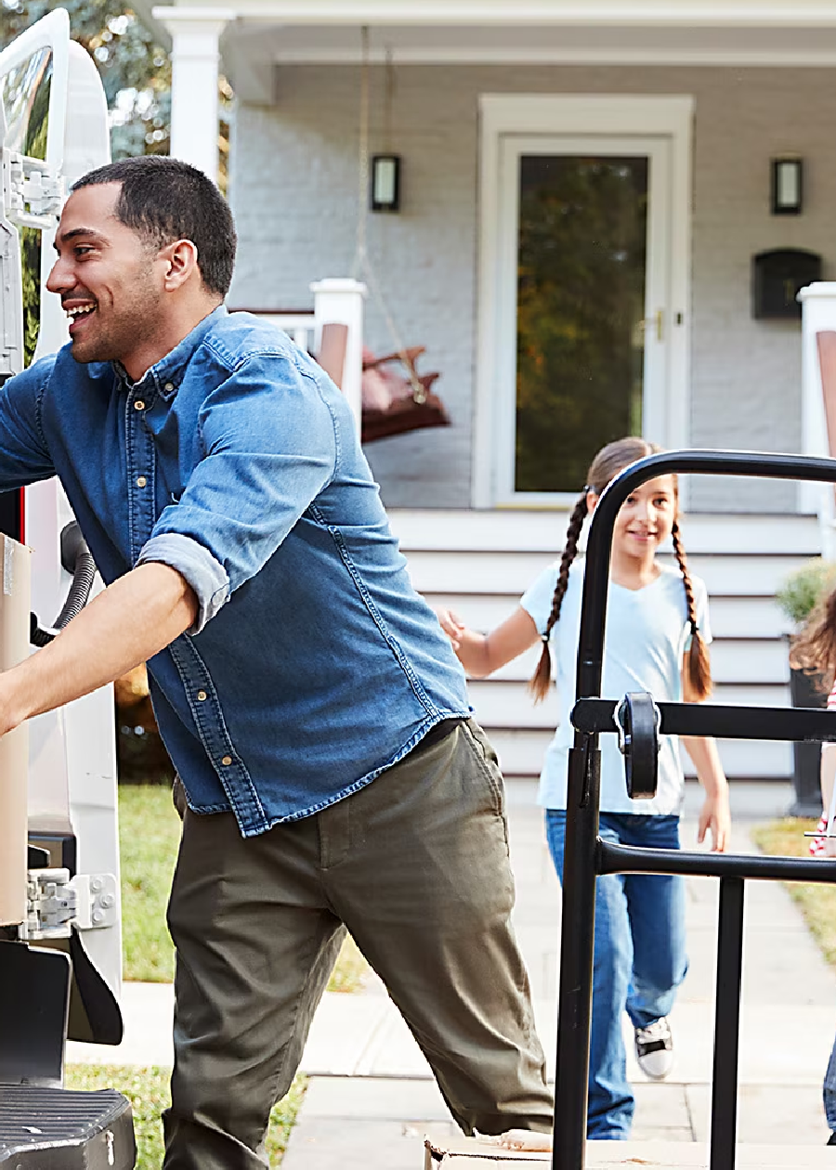
Human Activity Recognition Component Project using Tableau
We all know how crucial a healthy lifestyle is, and identifying the right physical activity plays a vital role. In this presentation, we will introduce you to the Human Activity Recognition (HAR) Component Project using Tableau.

Slide 2
Definition and Importance
What is HAR?
HAR is a technology that uses machine learning models to identify and recognise human activities from sensor-generated data.
Its Significance
The system provides real-time information about activities performed that is useful in several applications, such as healthcare or physical activity tracking.

Slide 3

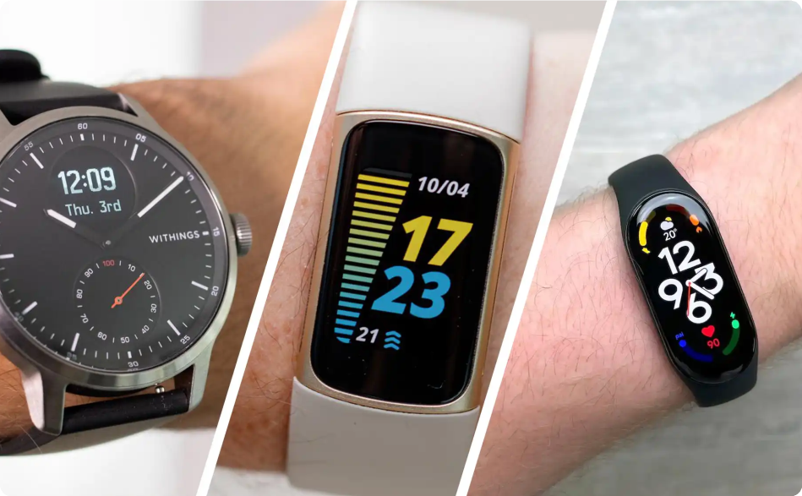
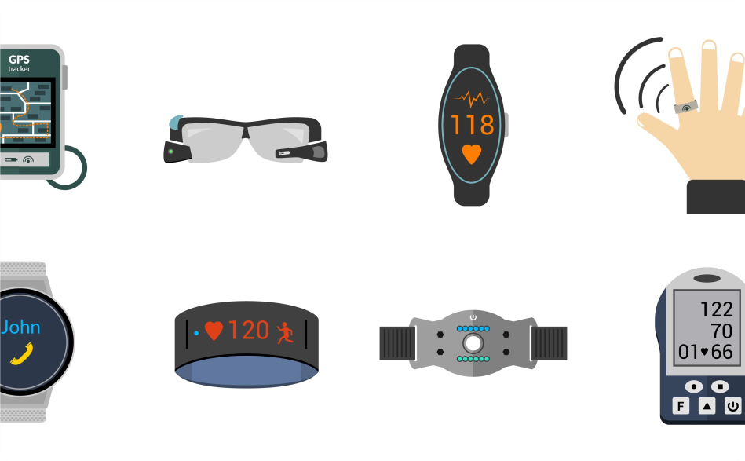
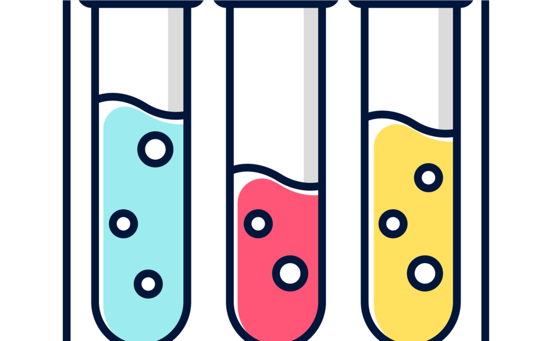
Data Collection
Activity Trackers
Collect data on various movements and activities, including sleep quality and calorie consumption.
Wearable Devices
Devices like Smartwatches and Bracelets to collect data and measure various activities.
Research Studies
Conducting data collection activities through research and surveys.

Slide 4
Data Presentation
Heat Mapping
Use heat maps to display the frequency and intensity of movements or activities.
Tables & Graphs
Convey insights through visual representation of large datasets using charts, graphs, and tables.
Sharing with Stakeholders
Three different ways to share the results - exporting image, copy and paste, and embedding into a webpage or an HTML text editor.

Slide 5

Preparing the HAR Data Set
Extracting Information
Extract and collect all relevant information from raw data sources.
Identifying Patterns
Detect patterns or anomalies in the data
Cleansing and Transforming
Cleanse and preprocess the data set by removing noise, transforming into suitable formats, and normalizing the data.

Slide 6
Dataset Selection
Role of Dataset
The choice of dataset is crucial in ensuring the effectiveness and accuracy of the developed HAR model.
Factors to Consider
Factors such as the size of the dataset, data format and structure, and the specifics of the targeted activities or movements that must be detected, should be considered.

Slide 7
Data Preprocessing
Feature Scaling
Normalize all the features to eliminate disparities in the data sets that may lead to biased output.
Feature Extraction
Identify the most relevant features in the dataset to increase the accuracy of
predictions.
Training Data Preparation
Separete the data into two sets: training sets, used in the training phase of the machine learning process, and testing/evaluation sets, used to evaluate the model's performance.

Slide 8
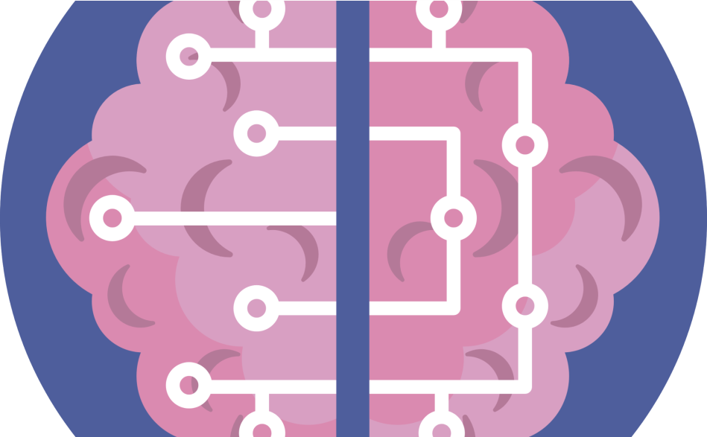
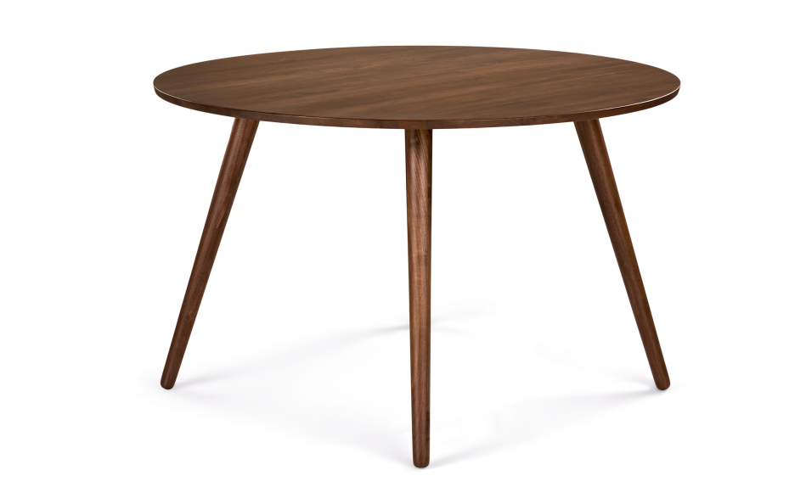
Model Selection
Machine Learning
Identify the best type of machine learning models like Random Forest, Neural Networks to be used for the Human Activity Recognition model.
Regression Analysis
Use regression analysis to study the relationships between variables and build predictive models.

Slide 9
Model Training and Evaluation
Model Training
Develop and train the chosen machine learning algorithm using the prepared dataset.
Model Evaluation
Evaluate the performance of the trained algorithm to avoid overfitting or underfitting.
Hyperparameter Tuning
Optimize the model's hyperparameters to enhance the model's performance.

Slide 10

Integrating Tableau for visual analysis
Data Import and
Preparation
Import data set into Tableau, create data sources, joins and blend data sets and create calculated fields.
Adding Interactivity and Filters
Add filters and interactivity to the visualizations for more insights and deeper analysis.
Introduction to Tableau
Understand the basics of Tableau, including the interface and functionalities.
Creating Interactive Visualization
Display performance metrics, trend summaries, and physical activity data in Tableau.
Building a Dashboard
Creating dashboards that provide the most important information and insights and shares it with stakeholders.

